Slide 1

UNDERSTANDING THE ROLE OF COMPUTER MEMORY
An Introduction to Fundamental Concepts in Computers and Memory.
Student Name : L.H.G.Yasiru Prabodha
Student Index : CL/OTHMFL3/11/90

Slide 2

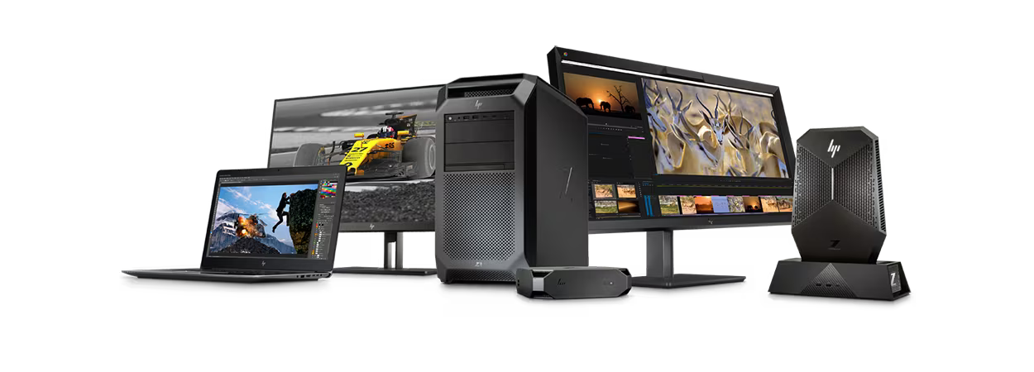
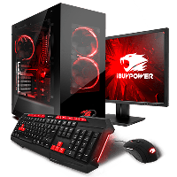
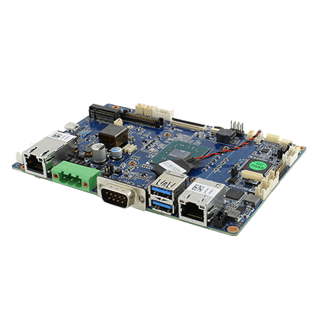
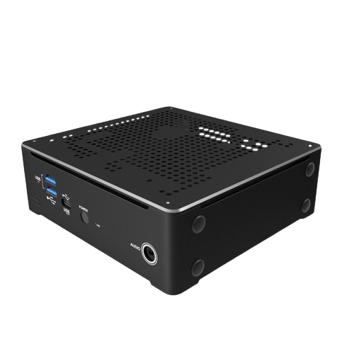
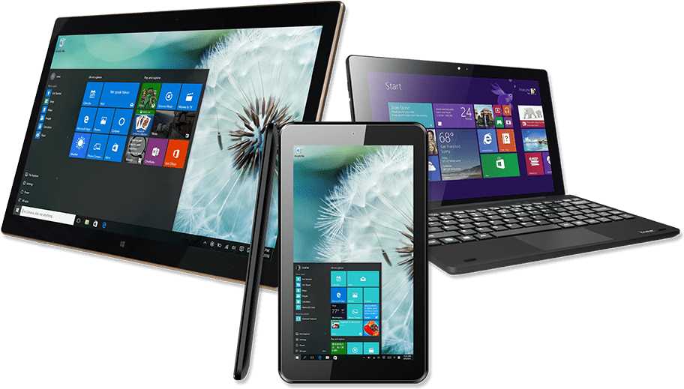
What is a Computer?
A computer is an advanced electronic device designed for efficiently processing, storing, and manipulating data to perform a wide range of tasks accurately and swiftly. It comes in various forms such as personal computers, desktops, laptops, smartphones, tablets, and large data centers, catering to diverse computing requirements.
The Importance of Computers
Education
Communication
Work and Productivity
Entertainment

Slide 3


﻿DIFFERENCE BETWEEN DATA AND INFORMATION
DATA
INFORMATION
﻿Data is raw, unorganized facts that need to be processed. Data can be something simple and seemingly random and useless until it is organized.
﻿When data is processed, organized, structured or presented in a given context so as to make it useful, it is called information.

Slide 4

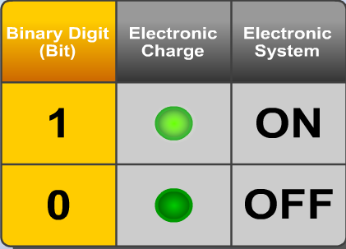
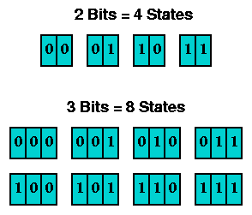
How Computers Represent Data Using Binary Code (0s and 1s)
Binary Digits (Bits)
Combinations of Bits (Bytes)
Computers rely on a binary system, which employs just two symbols, 0 and 1, to represent all sorts of data. This binary code serves as the fundamental language of computers and supports their capacity to process, store, and transfer information.

Slide 5

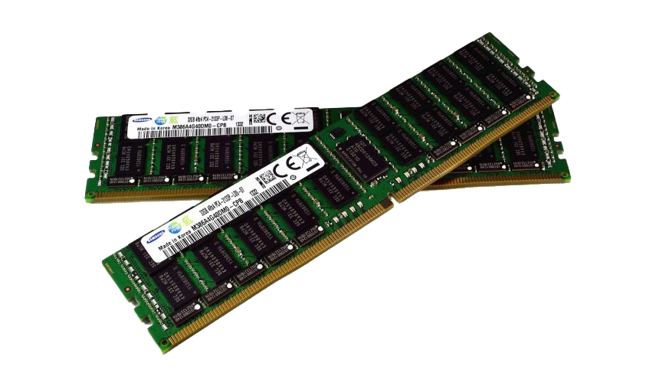
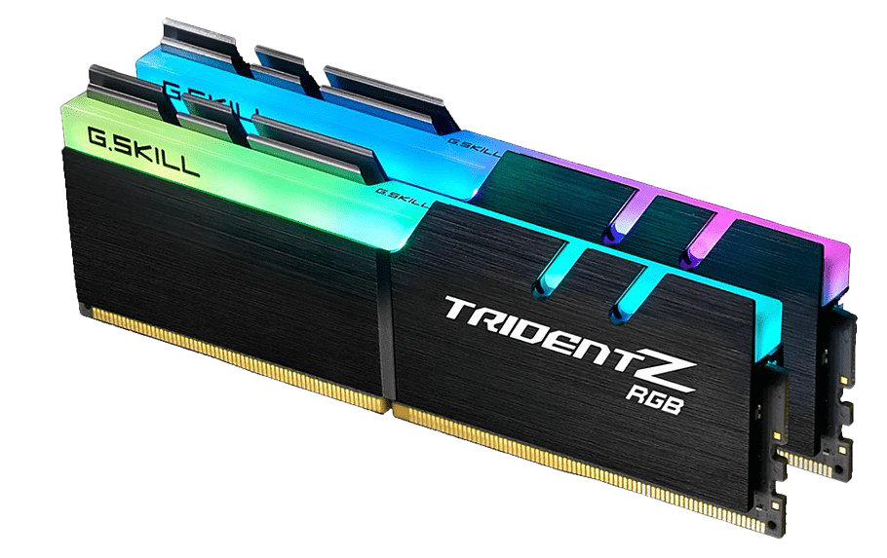
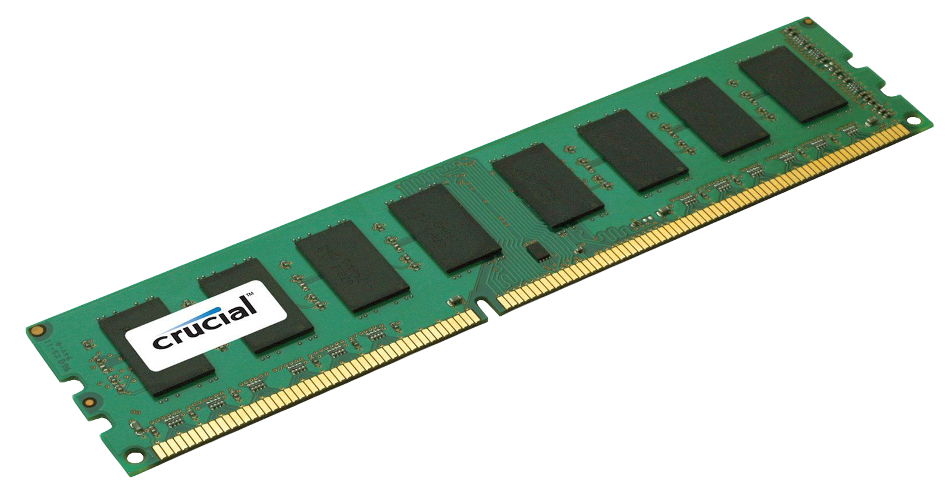
Defining Computer Memory
Computer memory, often simply referred to as "memory," is a crucial component of a computer system responsible for storing and managing data and instructions that the computer's processor (CPU) needs to access during its operations. Memory enables the computer to temporarily retain and quickly retrieve the information required for various tasks.
The Purpose of Computer Memory in a Computer System
The primary purpose of computer memory is to provide fast and efficient storage for data and instructions that are actively being used by the computer's CPU. Here's why memory is essential in a computer system
Virtual Memory: Modern computer systems employ virtual memory, which uses a combination of physical RAM and storage devices like hard drives to provide the illusion of a larger memory capacity. This ensures that the computer can handle large and complex tasks.

Slide 6

Types of Computer Memory
Faster Access
RAM (Random Access Memory)
ROM (Read-Only Memory)
Register
RAM is the primary volatile memory in a computer.
It stores data and program instructions that the CPU actively uses during operations.
RAM is fast but loses its contents when the computer is powered off.
ROM is non-volatile memory used to store essential system firmware and instructions.
ROM is responsible for booting up the computer and initializing hardware.
It retains its data even when the computer is turned off.
cache
Main memory
Electronic disk
Cache Memory
Virtual Memory
Magnetic disk
It allows the computer to handle large tasks by swapping data between RAM and storage as needed.
Virtual memory is a combination of physical RAM and storage space used when RAM capacity is exceeded.
Virtual memory ensures the system can run complex applications smoothly.
Cache memory is a small, high-speed memory unit located closer to the CPU.
It stores frequently accessed data and instructions to accelerate processing.
Cache memory improves the overall speed and efficiency of the computer.
optical disk
Magnetic tapes
Higher Capacity

Slide 7

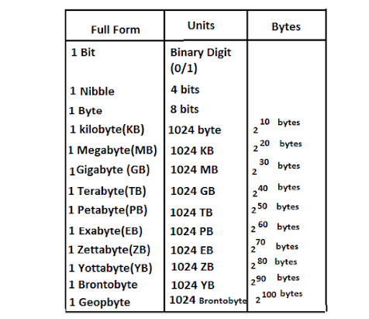
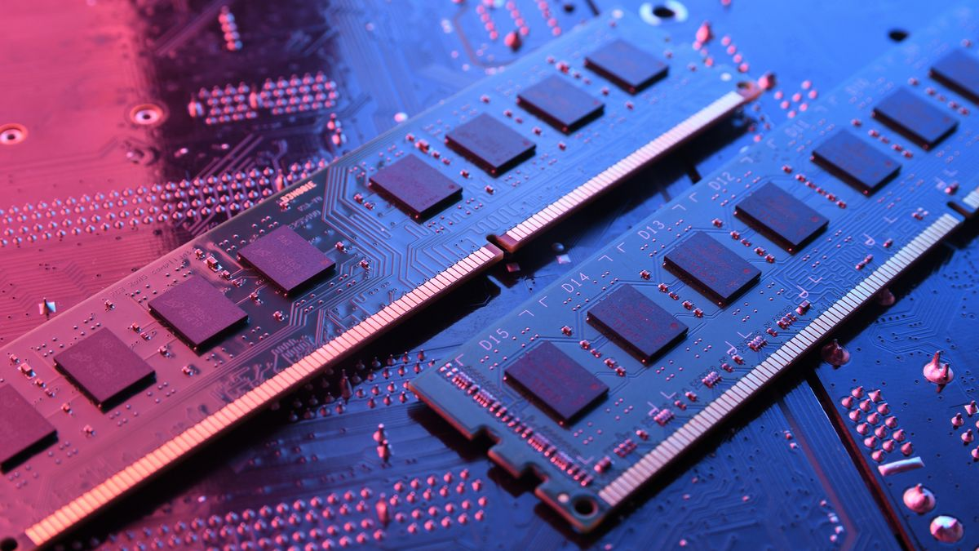
Units of Computer Memory

Slide 8

RAM Role
RAM (Random Access Memory) is vital to a computer's memory structure, providing short-term, fast-access storage for the CPU to execute tasks effectively. It enables multitasking by holding data and instructions temporarily. SRAM (Static RAM) offers speed but is expensive and used in CPU caches, while DRAM (Dynamic RAM), cheaper but slightly slower, serves as primary memory. The quantity and speed of RAM significantly influence a computer's performance, making it crucial for seamless operation.
SRAM (Static RAM) is quicker and more power-efficient than DRAM but is also more costly. It's widely utilized in CPU caches, where performance is vital. SRAM employs flip-flops to store data.
DRAM (Dynamic RAM) is more cheap and offers larger store capacity but is slightly slower than SRAM. It's the major form of memory utilised as main memory (RAM) in computers. DRAM stores data in capacitors and has to be updated frequently to retain data integrity.

Slide 9

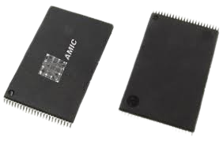
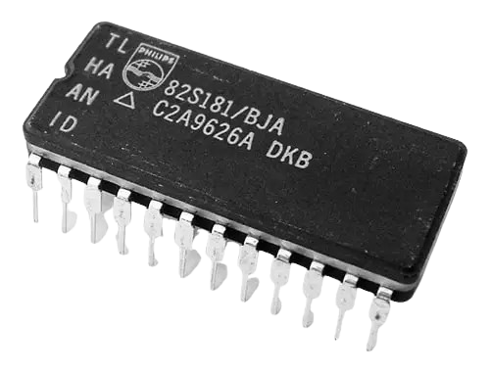
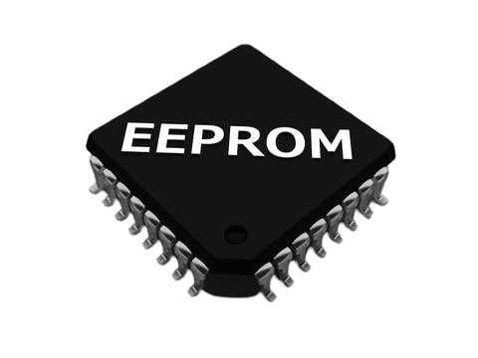
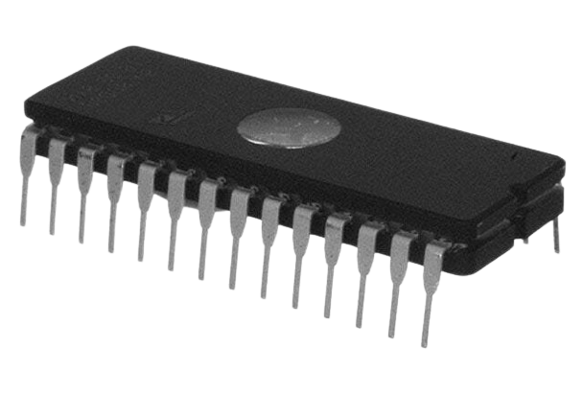
ROM and Its Role
Read-Only Memory (ROM) is an essential element in computers, storing permanent firmware and instructions that remain unchanged throughout a computer's lifespan. Unlike other memory types, ROM retains its data even when the computer is turned off and cannot be easily modified. It plays a crucial role during startup (booting) by initializing hardware components and loading the operating system into memory
There are several types of ROM
MROM (Mask ROM)
PROM (Programmable ROM)
EPROM (Erasable Programmable ROM)
EEPROM (Electrically Erasable Programmable ROM

Slide 10

THANK YOU

